Slide 1
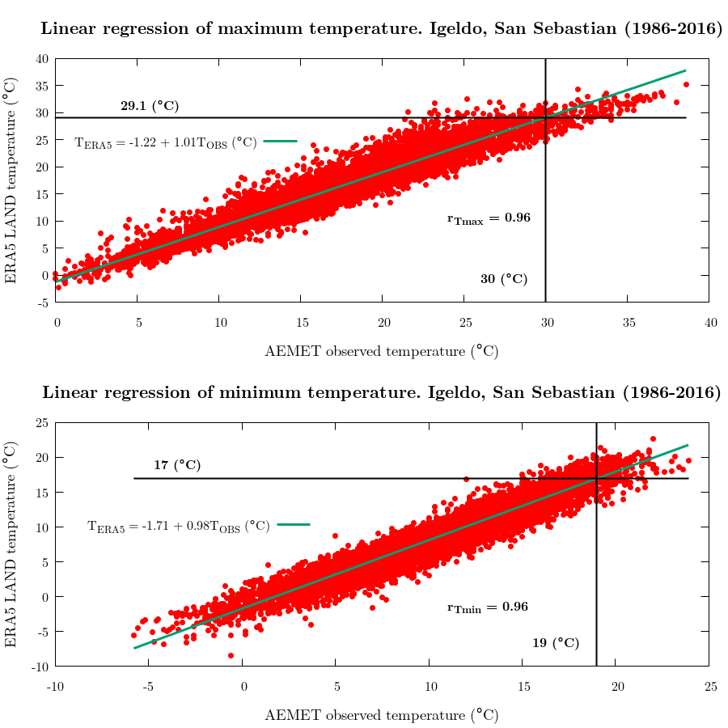
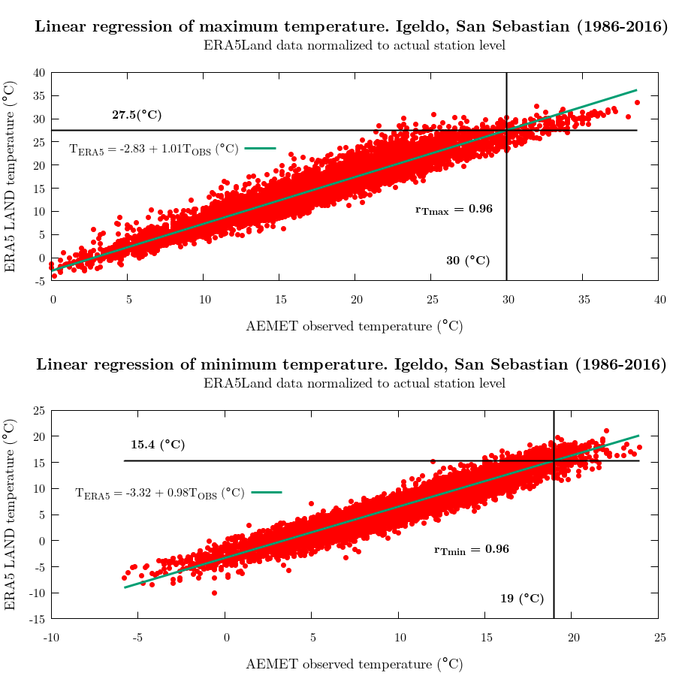
COASTAL ZONE: Igeldo-San Sebastian
i
AEMET Thresholds | ERA5Land Thresholds
T_{min} ≥ 19ºC T_{max} ≥ 30ºC | T_{min} ≥ 16,97ºC T_{max} ≥ 29,12ºC
AEMET Thresholds | ERA5Land Thresholds
T_{min} ≥ 19ºC T_{max} ≥ 30ºC | T_{min} ≥ 15,35ºC T_{max} ≥ 27,51ºC
AEMET station altitude | ERA5Land geopotential altitude
251 m | 361 m

Slide 2
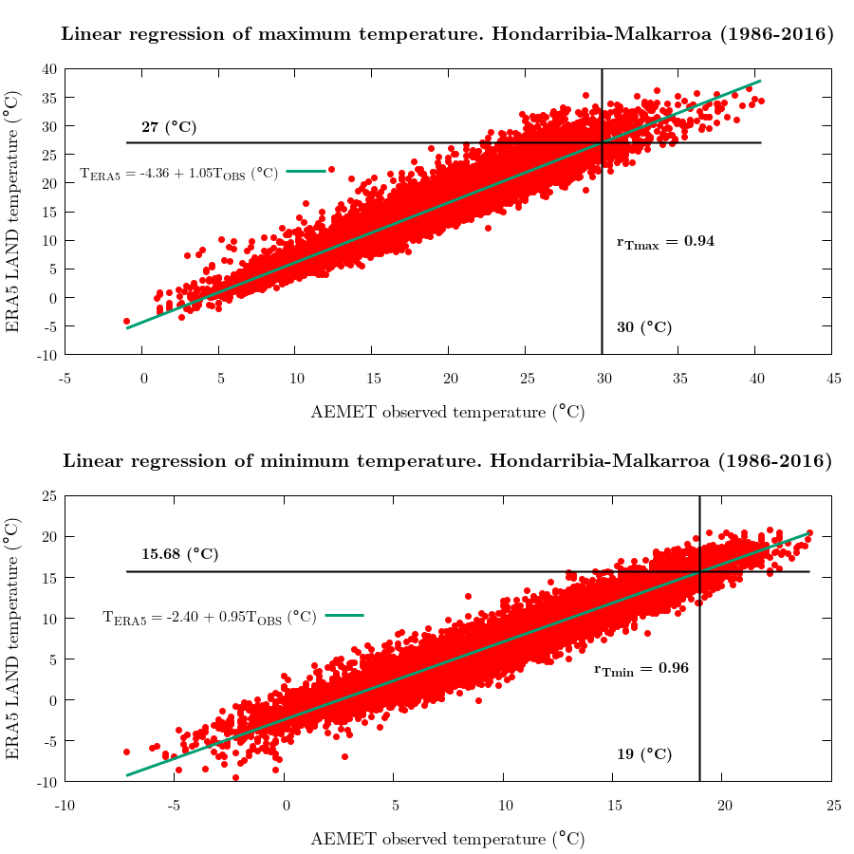
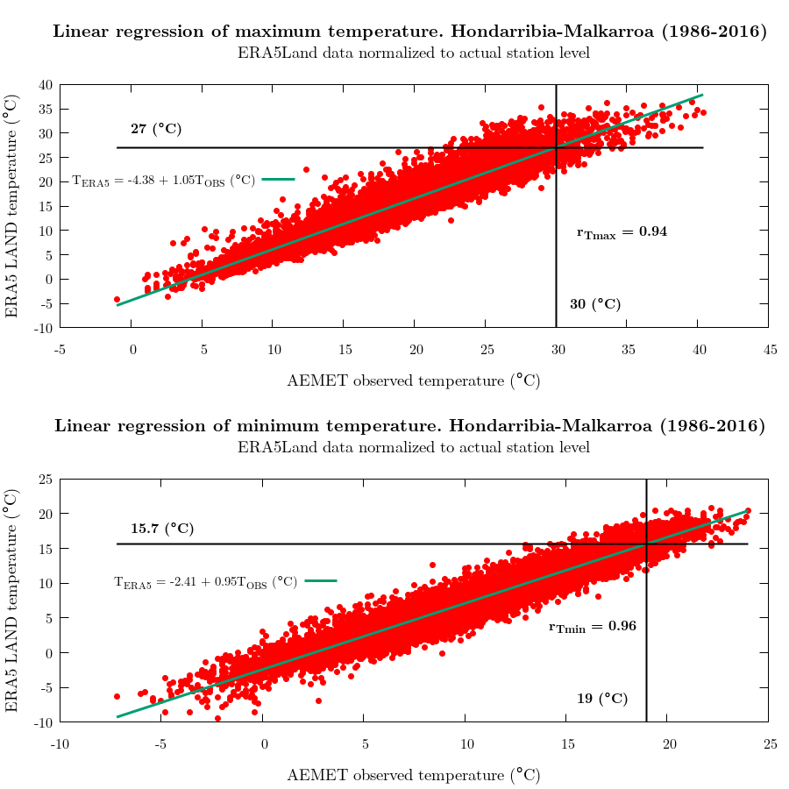
COASTAL ZONE: Hondarribia-Malkarroa
AEMET Thresholds | ERA5Land Thresholds
T_{min} ≥ 19ºC T_{max} ≥ 30ºC | T_{min} ≥ 15,68ºC T_{max} ≥ 27,05ºC
AEMET Thresholds | ERA5Land Thresholds
T_{min} ≥ 19ºC T_{max} ≥ 30ºC | T_{min} ≥ 15,66ºC T_{max} ≥ 27,03ºC
AEMET station altitude | ERA5Land geopotential altitude
4 m | 441 m

Slide 3
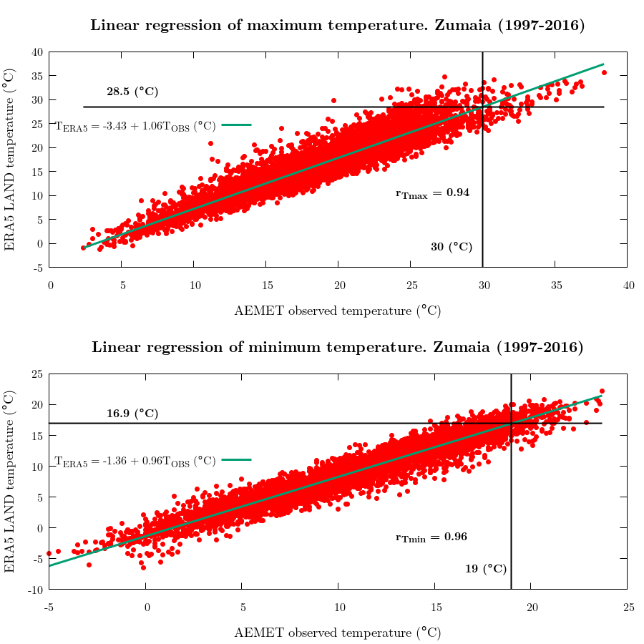
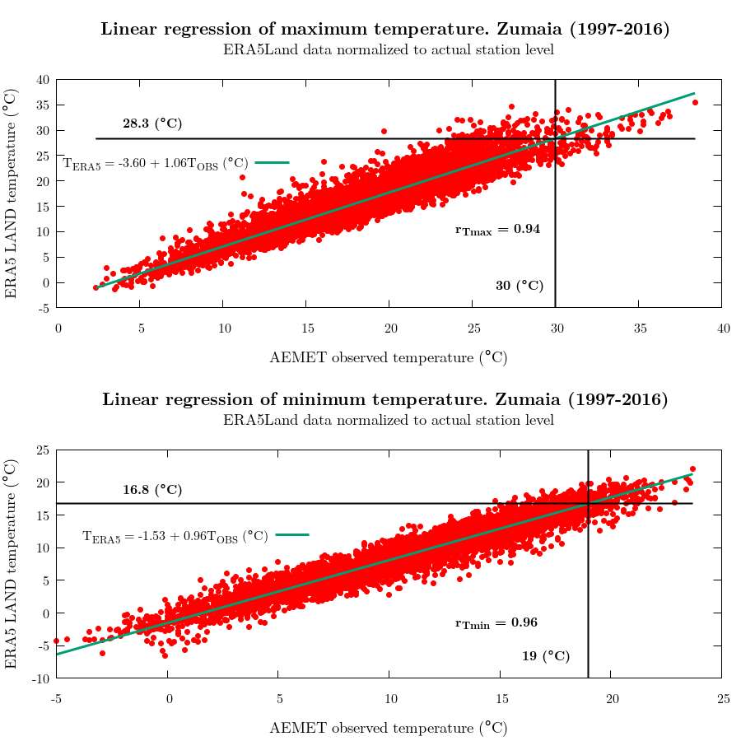
COASTAL ZONE: Zumaia
AEMET Thresholds | ERA5Land Thresholds
T_{min} ≥ 19ºC T_{max} ≥ 30ºC | T_{min} ≥ 16,93ºC T_{max} ≥ 28,51ºC
AEMET Thresholds | ERA5Land Thresholds
T_{min} ≥ 19ºC T_{max} ≥ 30ºC | T_{min} ≥ 16,76ºC T_{max} ≥ 28,34ºC
AEMET station altitude | ERA5Land geopotential altitude
28 m | 308 m

Slide 4
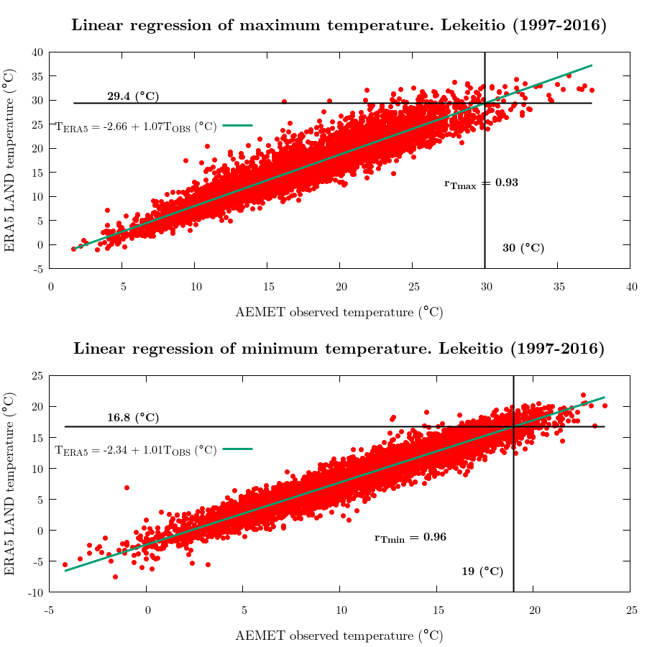
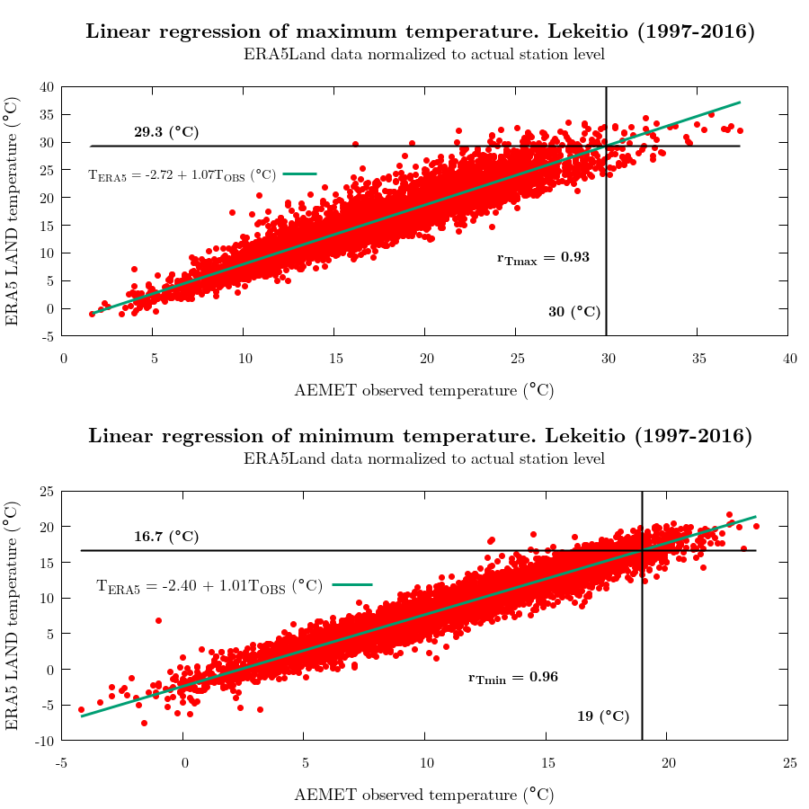
COASTAL ZONE: Lekeitio
AEMET Thresholds | ERA5Land Thresholds
T_{min} ≥ 19ºC T_{max} ≥ 30ºC | T_{min} ≥ 16,71ºC T_{max} ≥ 29,31ºC
AEMET station altitude | ERA5Land geopotential altitude
12 m | 345 m
AEMET Thresholds | ERA5Land Thresholds
T_{min} ≥ 19ºC T_{max} ≥ 30ºC | T_{min} ≥ 16,77ºC T_{max} ≥ 29,37ºC

Slide 5
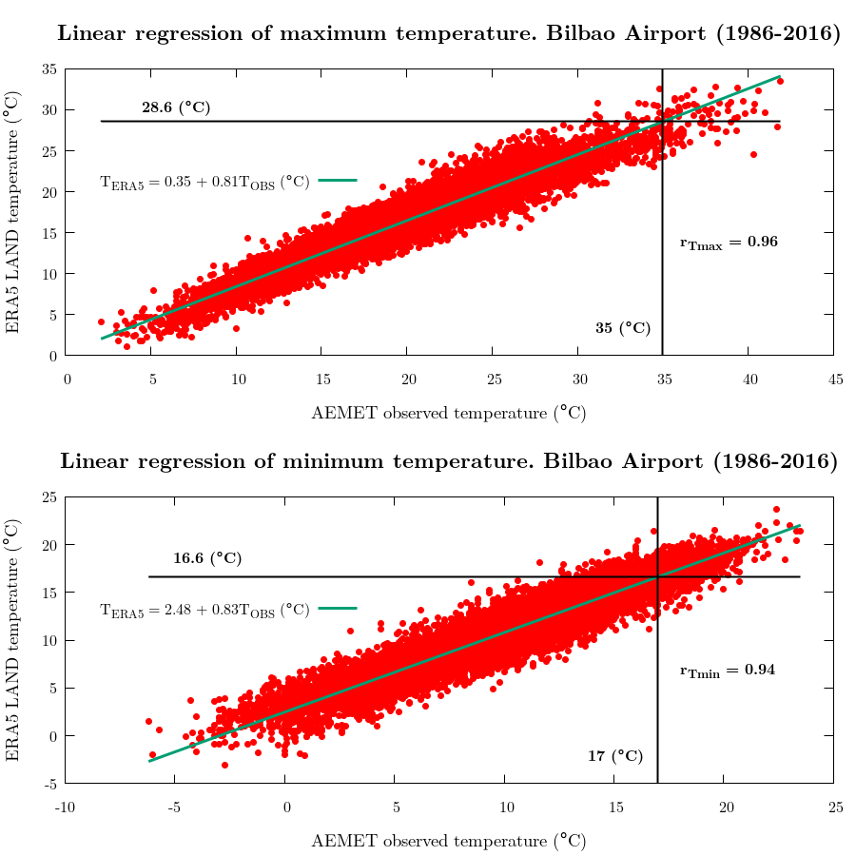
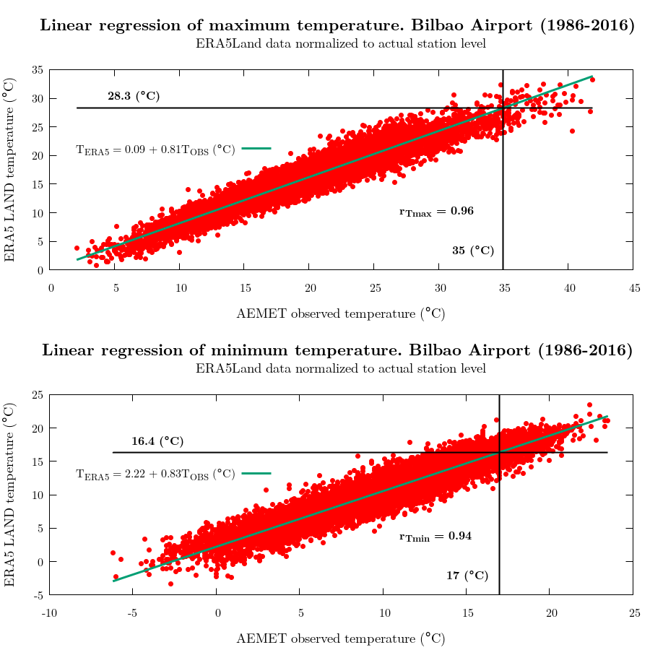
INLAND AREA: Bilbao airport
AEMET Thresholds | ERA5Land Thresholds
T_{min} ≥ 19ºC T_{max} ≥ 30ºC | T_{min} ≥ 16,37ºC T_{max} ≥ 28,30ºC
AEMET station altitude | ERA5Land geopotential altitude
42 m | 341 m
AEMET Thresholds | ERA5Land Thresholds
T_{min} ≥ 19ºC T_{max} ≥ 30ºC | T_{min} ≥ 16,63ºC T_{max} ≥ 28,56ºC

Slide 6
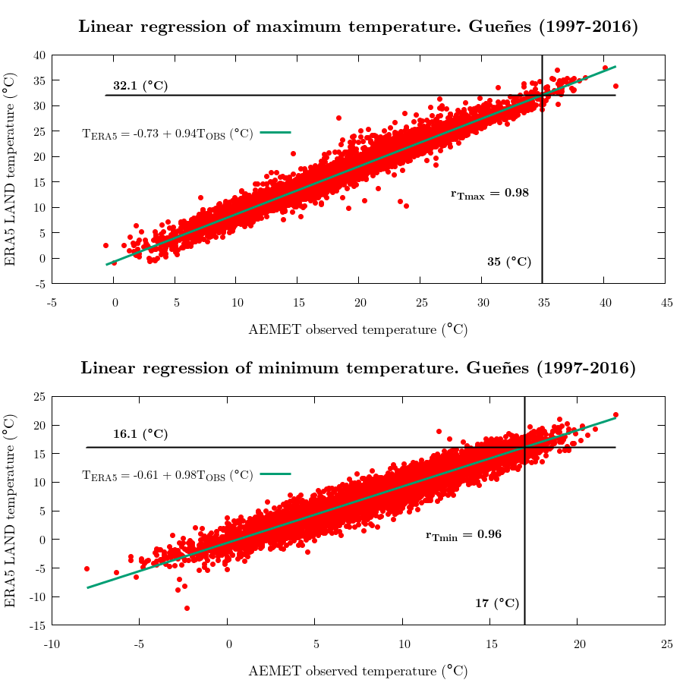
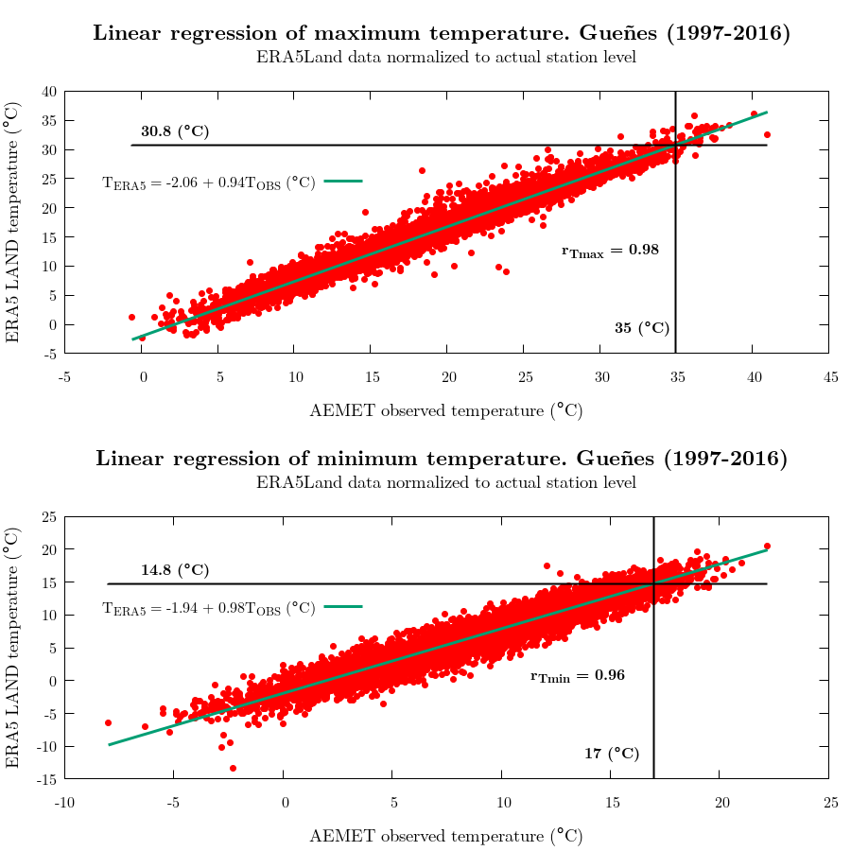
COASTAL ZONE: Gueñes
AEMET Thresholds | ERA5Land Thresholds
T_{min} ≥ 19ºC T_{max} ≥ 30ºC | T_{min} ≥ 16,13ºC T_{max} ≥ 32,12ºC
AEMET Thresholds | ERA5Land Thresholds
T_{min} ≥ 19ºC T_{max} ≥ 30ºC | T_{min} ≥ 14,8ºC T_{max} ≥ 30,78ºC
AEMET station altitude | ERA5Land geopotential altitude
208 m | 437 m

Slide 7
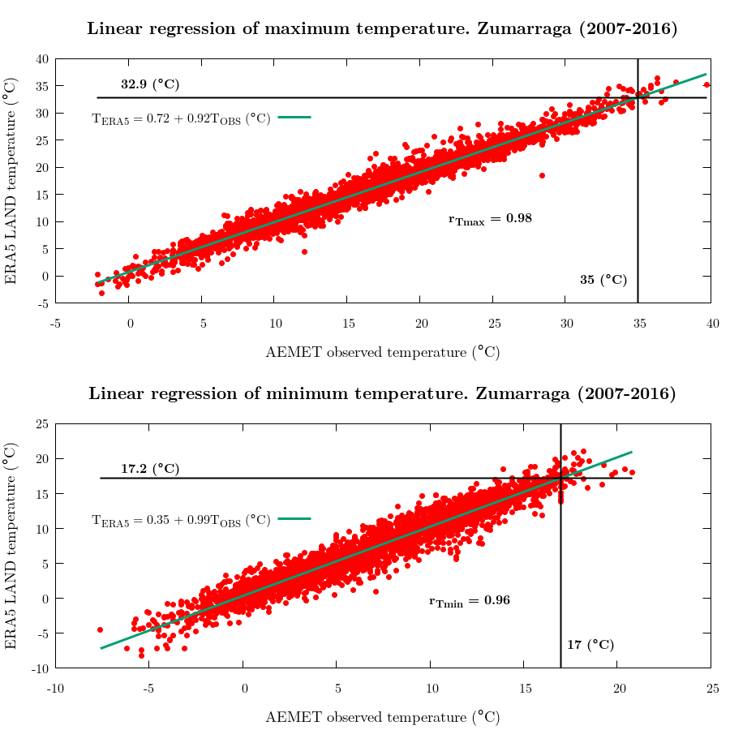
COASTAL ZONE: Zumarraga
AEMET Thresholds | ERA5Land Thresholds
T_{min} ≥ 19ºC T_{max} ≥ 30ºC | T_{min} ≥ 17,21ºC T_{max} ≥ 32,87ºC
AEMET Thresholds | ERA5Land Thresholds
T_{min} ≥ 19ºC T_{max} ≥ 30ºC | T_{min} ≥ 14,49ºC T_{max} ≥ 30,15ºC
AEMET station altitude | ERA5Land geopotential altitude
420 m | 582 m

Slide 8
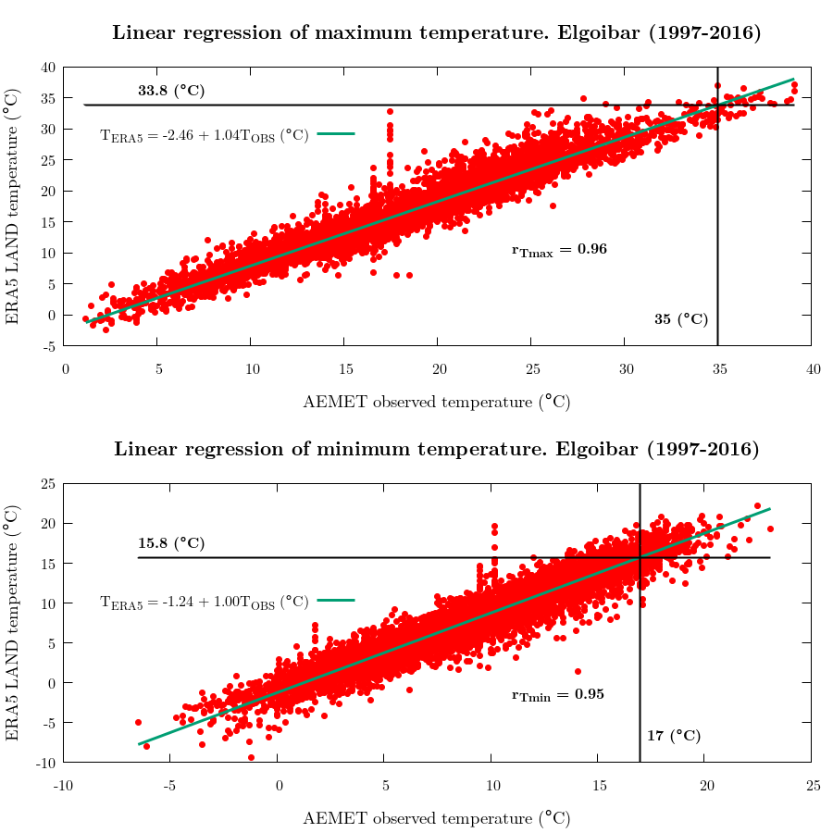
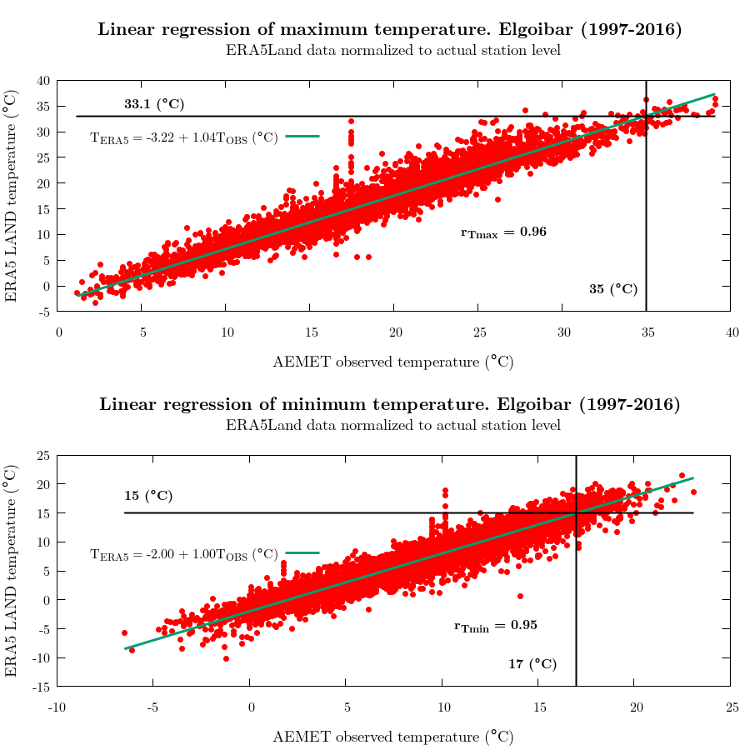
COASTAL ZONE: Elgoibar
AEMET Thresholds | ERA5Land Thresholds
T_{min} ≥ 19ºC T_{max} ≥ 30ºC | T_{min} ≥ 15,75ºC T_{max} ≥ 33,84ºC
AEMET Thresholds | ERA5Land Thresholds
T_{min} ≥ 19ºC T_{max} ≥ 30ºC | T_{min} ≥ 14,99ºC T_{max} ≥ 33,08ºC
AEMET station altitude | ERA5Land geopotential altitude
119 m | 417 m

